Slide 1
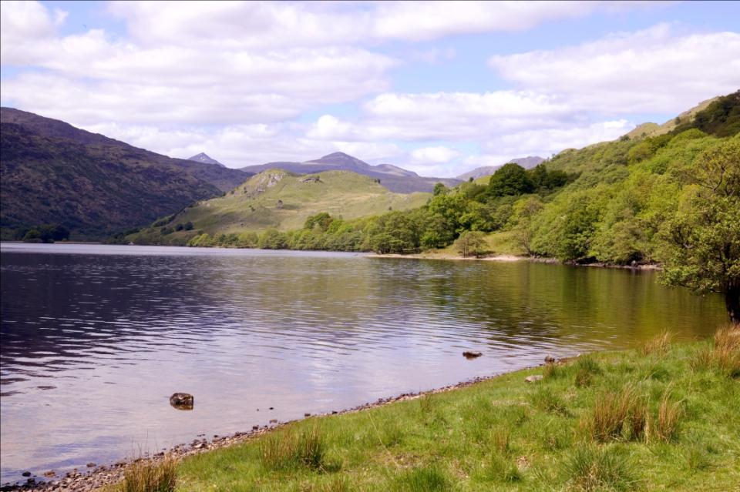
OVERVIEW
Association of Deer Management Groups
Running a highland estate – a profile of Glen Falloch
Fleming Family & Partners
19th June 2013

Slide 2
Deer Management in Scotland
- one view
Forest Policy Group submission to Land Reform Review Group 2013
“The current system …is no longer fit for purpose in the 21st Century.
“It reflects long-outdated assumptions about the balance of land use interests most suited to the nation’s needs.
“Its reliance on voluntary participation places many aspects of wider public interest in serious jeopardy.
“……damage is being caused….by excessive dominance of one set of interests….”

Slide 3
Glenfalloch Estate – at a glance
Traditional deer and farming highland estate
Hydro schemes
Third generation of family ownership
In the Loch Lomond National Park
Hardly remote…………..
  West Highland Way
  7 Munros
  A82

Slide 4
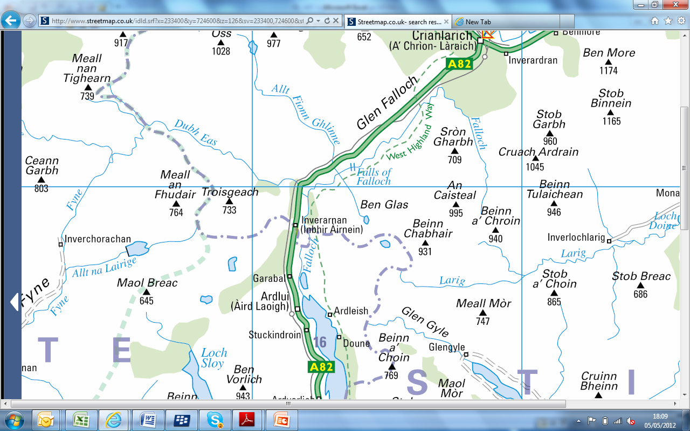
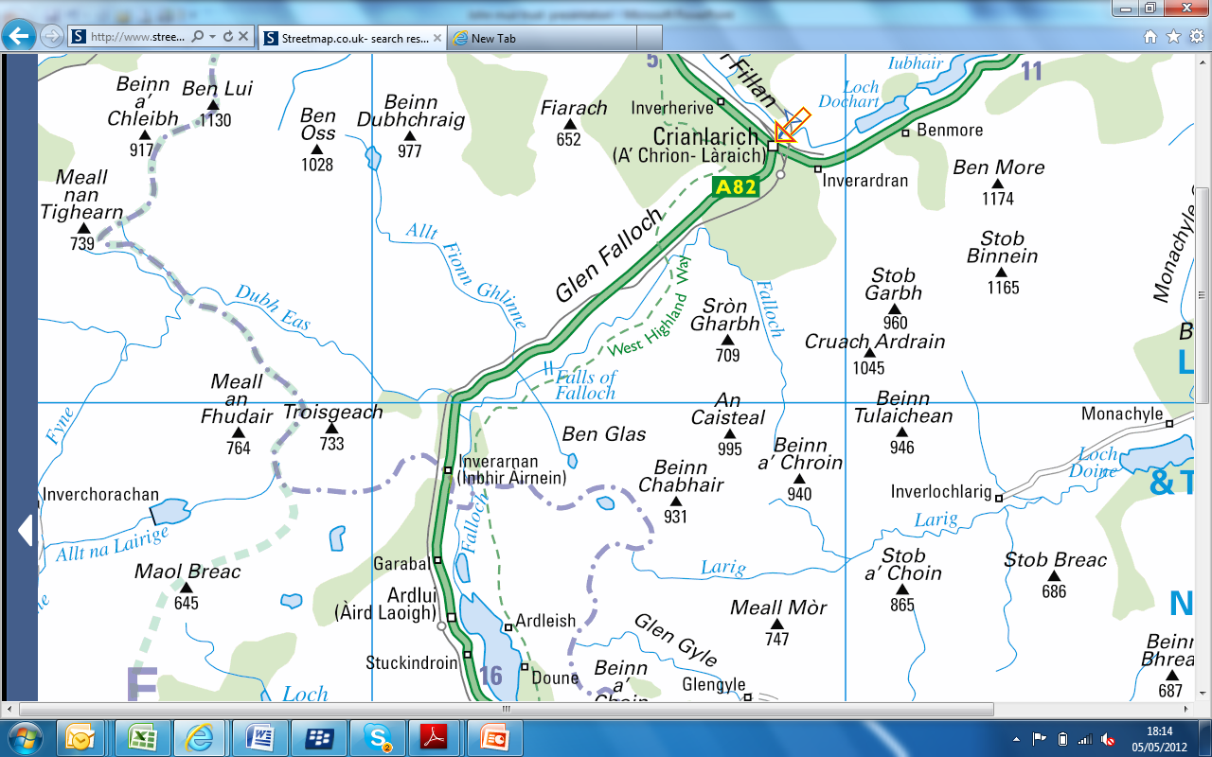
Glen Falloch Estate

Slide 5
Primary Objectives
  Within constraints of a limited budget
  to maintain current activities and preserve the traditional character of the estate
  Maintain and improve the natural habitat and bio-diversity for the benefit of the estate, the community and for rural Scotland

Slide 6
The recent past
West Highland Way / National Park / Land Reform
Glenfalloch Farm farmed in hand from 1997
Third generation management from 2001/2
Engagement with National Park, SNH and others
  Designated sites
  National Park Plan
  Land Use Management Plan (National Park support)
  Hydro schemes

Slide 7
Income 2008-13

Slide 8
Expenditure 2008-13

Slide 9
Surplus / Deficit
(excluding exceptional items)

Slide 10
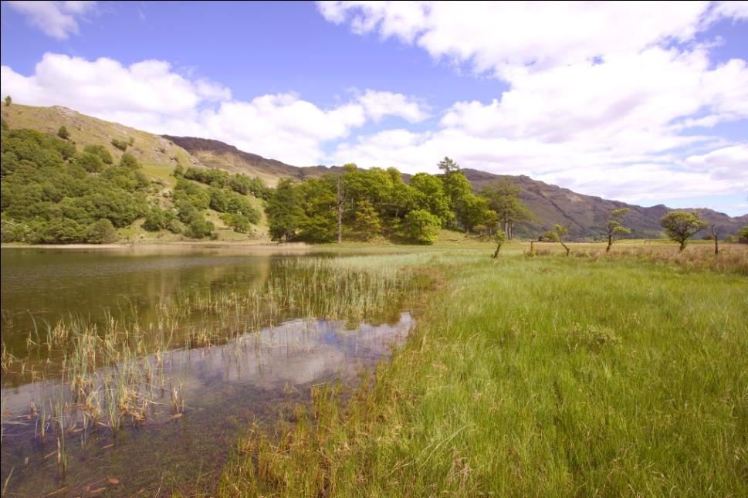
Habitat Management

Slide 11
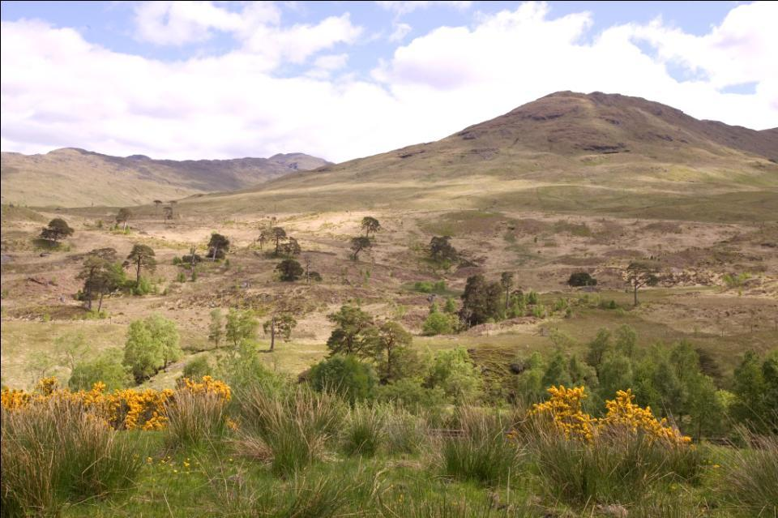

Slide 12
Environmental designations
Special Area of Conservation
5 Sites of Special Scientific Interest:
    Gael / Dubh lochs – Cnap Mor
    Caledonian pine woods
    Ben More / Stob Binnien
    Pollochro woods
    Oak woods by viaduct (“Confluence Woodland”)
National Scenic Area
Special Protection Area

Slide 13
Habitat Management
Land Use Management Plan
Forest Plan
Scottish Rural Development Programme
Environmental designations
Integrate these with farming and sporting objectives

Slide 14
Deer management
Aim to improve the quality of the herd by:
  Selective culling – no trophies
  Control of numbers consistent with long term carrying capacity of the land / habitat
  Use to manage level of grazing to avoid overgrowth
Adhere to Deer Code regarding welfare, participants, neighbouring interests
DSC Level 1 mandatory and Level 2 encouraged
Members of Scottish Quality Wild Venison
Members of the Association of Deer Management Groups and participants in two local DMGs

Slide 15
Deer Cull

Slide 16
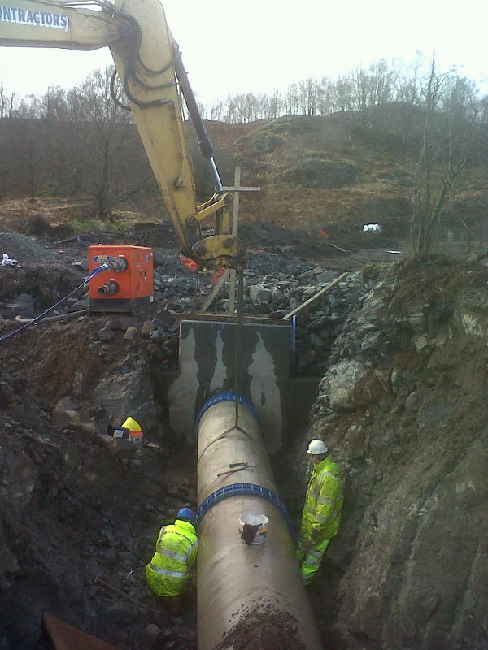
H
Hydro schemes

Slide 17
Hydro schemes
A major opportunity
Long period of development – 1992 - 2002
2005 estate re-started and took control of development process
2008 applications re-submitted 2009
Commissioned first scheme 2012
Remaining 3 schemes to be financed and constructed

Slide 18
Glenfalloch in rural Scotland
Member of Deer Management Groups
  Deer Code compliance
  Wildlife and Natural Environment Act
Scottish Land & Estates
  Political lobbying
  Putting the land owners’ case
Wildlife Estates Scotland
  Accreditation, standards of management and best practice

Slide 19
Putting the Glenfalloch case
Scottish Natural Heritage
Loch Lomond National Park
Loch Lomond Fisheries Trust / Angling Improvement Association
Forestry Commission
John Muir Trust
Mountaineering Council of Scotland
Scottish Canoeing Association
Strathfillan Community Council

Slide 20
Putting the Glenfalloch case
Murdo Fraser MSP
Bruce Crawford MSP
Richard Lochhead MSP
Greg Barker MP
Fergus Ewing MSP
Sir Peter Housden, Permanent Secretary Scottish Government
David Wilson, Director, Energy & Climate Change Directorate

Slide 21
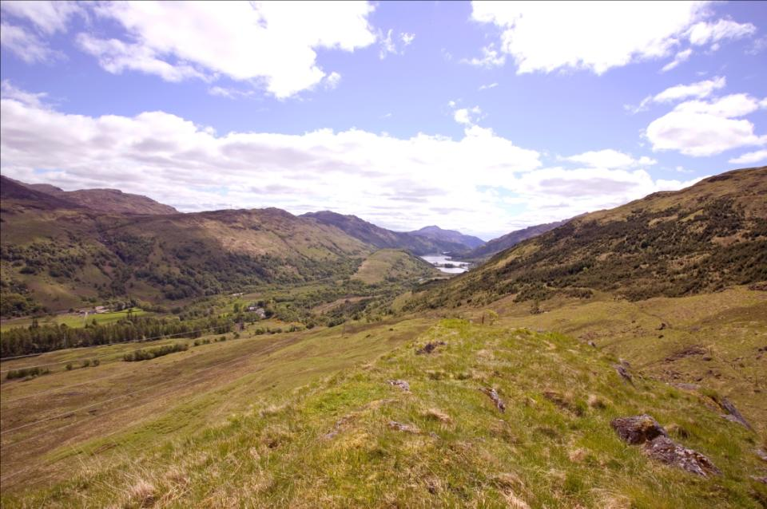
Conclusions

Slide 22
Deer Management in Scotland
- one view
Forest Policy Group submission to Land Reform Review Group 2013
“The current system …is no longer fit for purpose in the 21st Century.
“It reflects long-outdated assumptions about the balance of land use interests most suited to the nation’s needs.
“Its reliance on voluntary participation places many aspects of wider public interest in serious jeopardy.
“……damage is being caused….by excessive dominance of one set of interests….”

Slide 23
Deer Management in Scotland – another view
Zoe Kemp, SNH Operations Manager, January 2013
Before:
“I am an ex-vegetarian (but only just) and at the SNH Wildlife Management course about ten years ago I steadfastly refused to touch, never mind hold, a rifle.
“I am also proudly urban, a keen hill walker and decidedly left of centre”

Slide 24
Deer Management in Scotland – another view
After
“I understand more about the business [estate managers] are in and how deer fit into upland estate management.
“I understand that the Estate is run as a business. But, I do firmly believe they have the quality of the land, and the benefits it provides, to both themselves and wider society, at heart.”

